Slide 1
CSI Elite
Ver 1.0

Slide 2
CSI Elite
It’s all about premium experience
1 month privileges:
Enhanced gameplay
Faster energy generating time (2m/1energy)
More gadgets limits per day (15 uses)
Buy Elite only item
Deco
Avatar
Energy

Slide 3
UIs will be impacted
Shop UI
Need elite item
Need an elite tag for all items
Main UI
Elite promotion icon
Elite promotion UI
Avatar UI
Need elite tag for all items

Slide 4
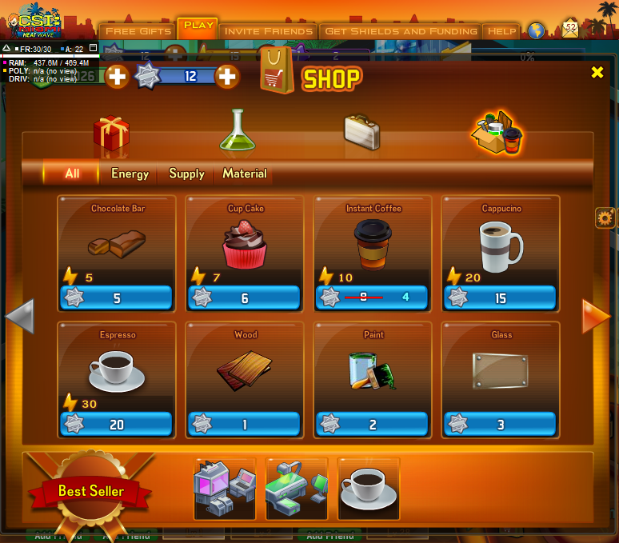


UI

Slide 5
UI
Join Elite

Slide 6

UI
Join CSI Elite
X
By Join the Elite, you can:
-Generate energy faster
(2min per energy)
-More gadget allowance
(15 gadgets per day)
-Elite only items
(Item with icon)
Join: 30

Slide 7
UI
Congratulations!
X
You’ve joined the CSI Elite now, enjoy your 1-month premium CSI experience!
(You can always click icon to see more info.)
OK

Slide 8
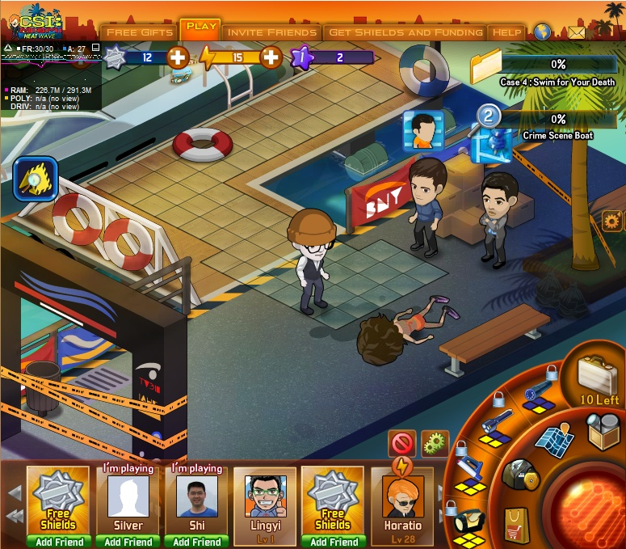
UI

Slide 9
UI
CSI Elite
30 Days
Remaining
Click to see privileges of CSI Elite

Slide 10
UI
CSI Elite Privileges
X
By Join the Elite, you can:
-Generate energy faster
(2min per energy)
-More gadget allowance
(15 gadgets per day)
-Elite only items
(Item with icon)
OK

Slide 11
Different periods of CSI elite
1 Day
7 Day
1 Month
2 Month
1 Year
Life time long (god I am so evil!)

